Slide 1


Movies Industry
By: Mona AL-Nasser

Slide 2


I worked on IMDb (Internet Movie Databases). It is the most popular movie website. This website is storing almost every movie has been released.
As I’m a movie fan
I really enjoyed working on this dataset.

Slide 3

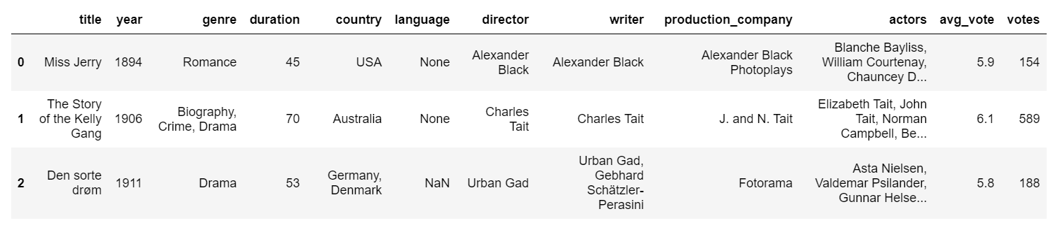
This dataset contains : 85,855 movies 22 attributes such as: movie title, year, genre, duration, country, average rating, etc. you can find it at Kaggle in this link: IMDb movies extensive dataset | Kaggle.

Slide 4


Data Cleaning:
Kept only the columns I need it (I kept only 12 columns)
(Title, year, genre, duration, country, language, director, writer, Production company, actors, average vote, votes).
Dropped all the missing values.
Dropped the duplicated rows.
Deleted any movie released before year 2000.
Changed the type of column(year) to integer.

Slide 5

From this dataset I was curious to find answers for some questions such as:

Slide 6
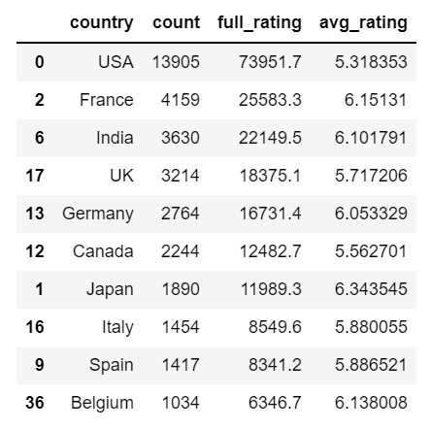
The top (10) countries producing movies

Slide 7
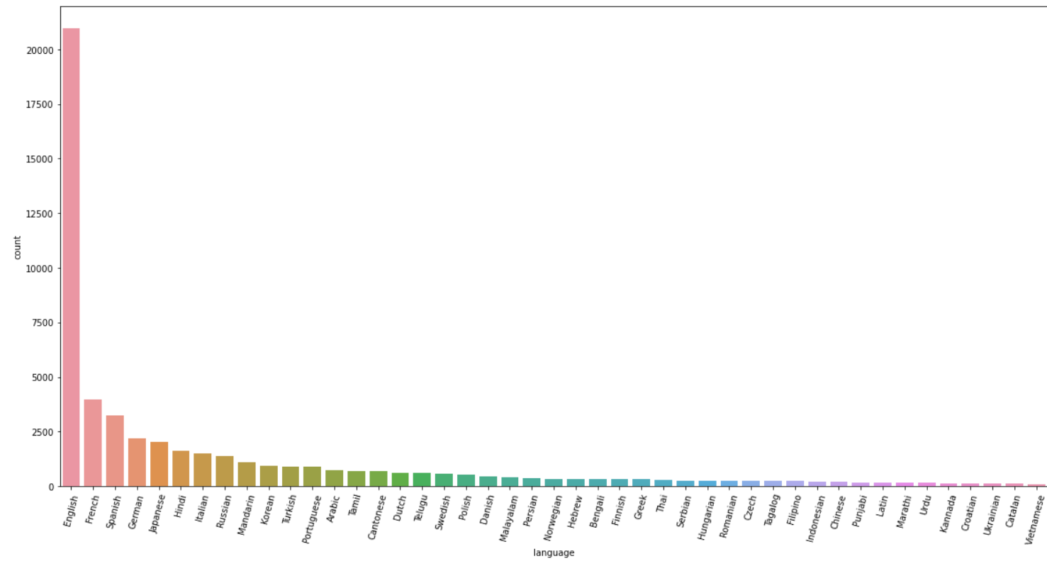
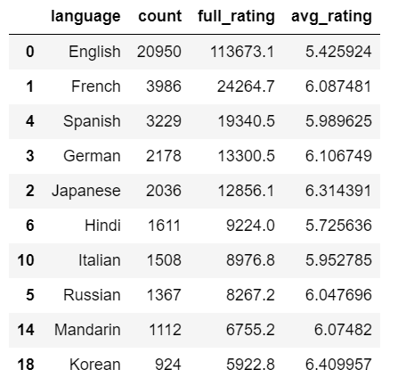
The top (10) Languages in which movies are produced

Slide 8
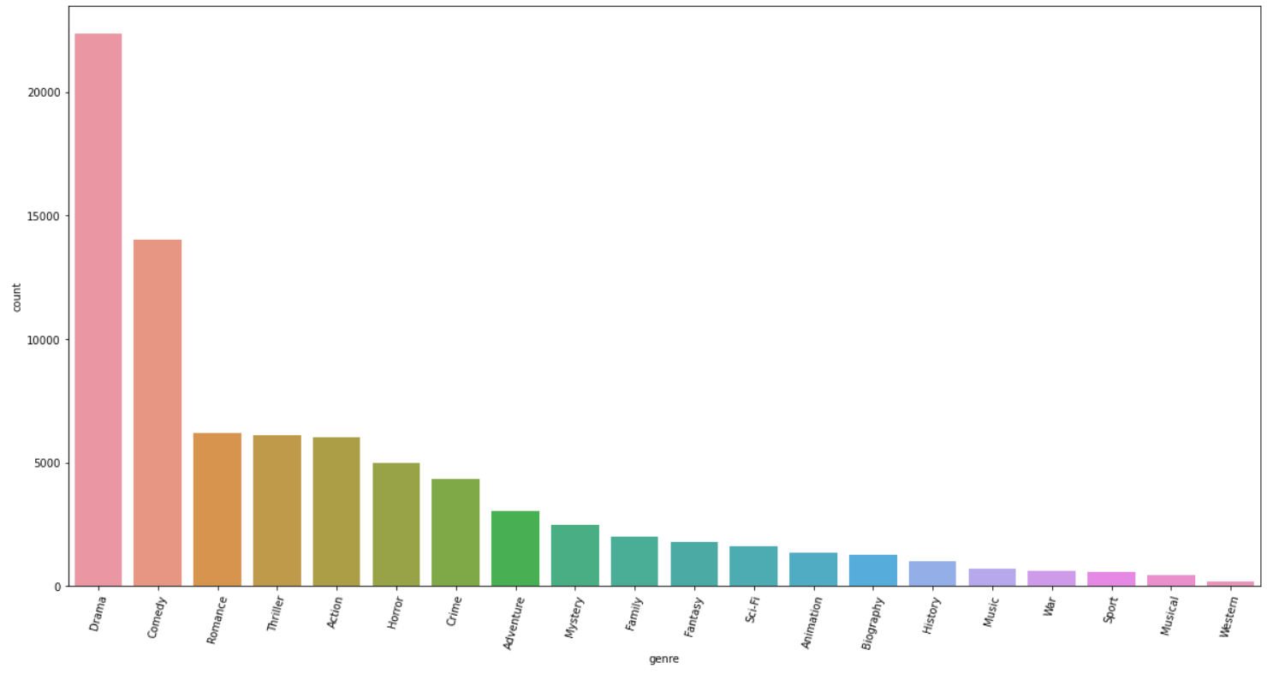
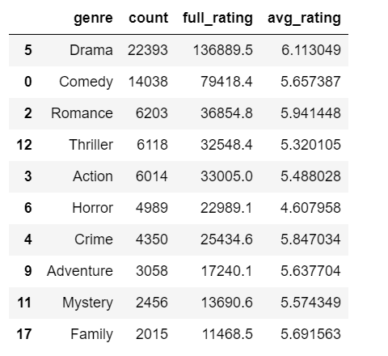
The most genres the movies made in

Slide 9
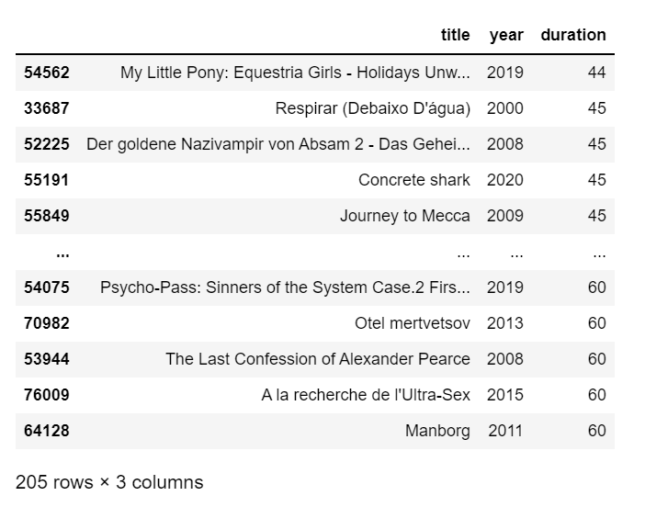
List of short movies (shorter than 60 minutes):

Slide 10
The shortest movie in IMDb
Title | My Little Pony: Equestria Girls - Holidays
Producing year | 2019
Duration | 44 minutes

Slide 11


The Longest movie in IMDb
Title | La flor
Producing year | 2016
Duration | 808 minutes → more than 13 hours

Slide 12
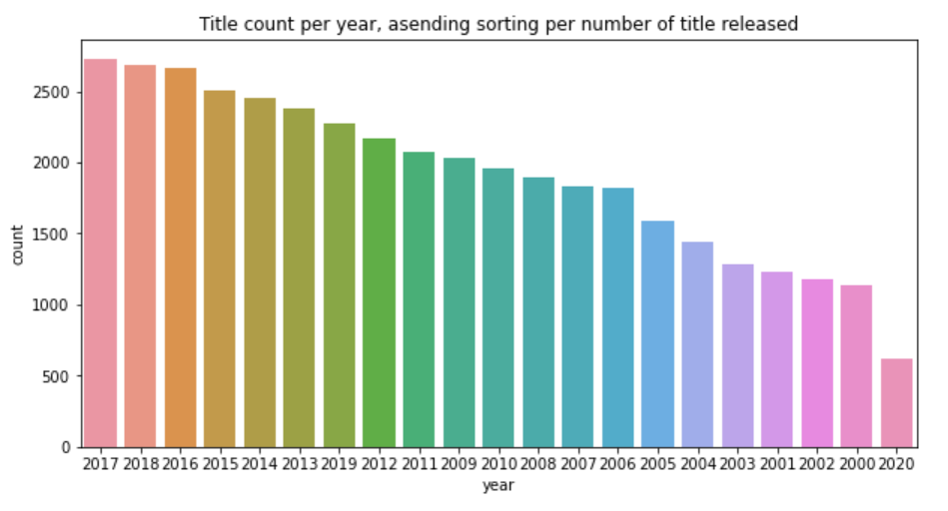
After that, I looked for which year was the best year of production movies
We can see the best year for movies production was 2017

Slide 13

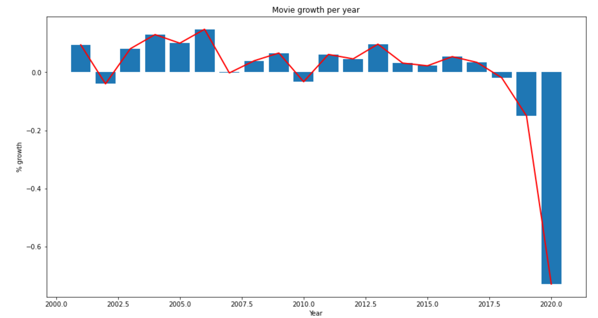
In this chart, I want to find the number of movies produced each year and we can notice the drop in production in Year 2020 because of COVID-19 Pandemic.
Depend on this chart, I find a relation between the years and the number of movies produced each year

Slide 14
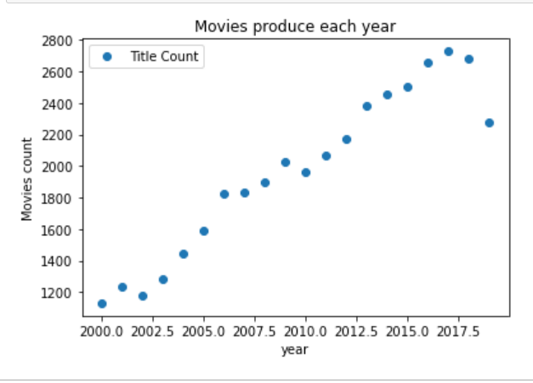
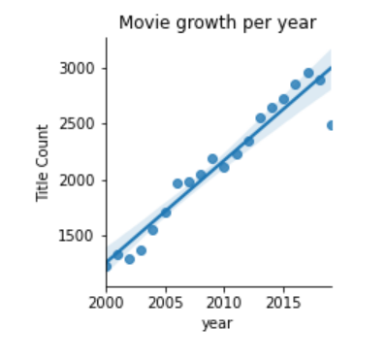
So, I presented it like a Linear relationship
Then, I built a Model to predict the number of movies will produce next year.

Slide 15
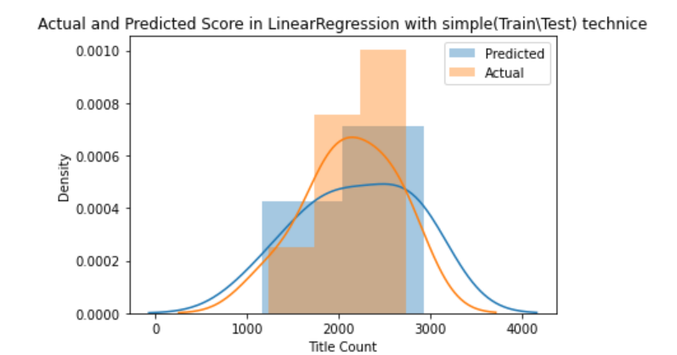
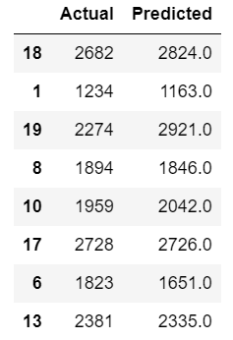
The best Model to predict the target was: The simple linear regression with simple (train and test) techniques. It’s score R^2 = 0.719 on the test set.
I used a … Regression\ Supervised \Machine Learning algorithms such as:
LinearRegression, Ridge , and PolynomialRegression
These models take the year → predict the number of movies produced in this year

Slide 16
Thank you
I hope you like my work
And enjoying this presentation
Mona AL-Nasser

